Slide 1
Automation and Scale on Azure An Introduction to ARM templates
Shane Baldacchino
Notes:
Hi All, My name is Shane Baldacchino and tonight I want to talk to you about Automation and Scale on Azure using ARM templates
If at any time tonight you have questions feel free to jump in

Slide 2
Who Am I
Architecture Manager At Simplot Australia
Home of Australia’s favourite food brands
Lived and breathed Online for 15+ years
Self Employed Hosting Company ~200 physical servers – 8 years
SEEK - Infrastructure Architect – 7 years
Automation first mantra
Notes:
Before I get started just a little bit about me and my background.
Prior to my current role I have been involved in the hosting game for about 15 years. from running 10’s of thousands of websites on stand alone IIS / Apache webservers to ensuring the infrastructure behind one of Australias most popular websites is fit for purpose
For those who haven’t heard of Simplot we are Australias largest food manufactuer and on avaereage everyone here will have consumed one of our products today
HTTP status codes are seldom buss words in the office. My role is to manage a team of Architects who are responsible for all technologies ranging from our core ERP and integration platforms to our infrastructure. We have hundreds of applications spanning many manufacturing sites in Australasia
We have ‘traditional’ infrastructure and as we attempt to drive down costs, increase availability and move faster it is clear that our platforms are dated and limiting our aspirations. To solve our problems we are looking at a hybrid cloud model so our infrastructure becomes less of a road block and more of an enabler for our business. I try to live what I preach. About a six to nine months ago, we made the call to start transitioning our infrastructure from on premise and to start testing the waters with Azure IaaS / PaaS solutions
Automation has always been a massive thing for me. From the hobbies at my house to the my hosting days. Anything that can make our jobs easier is something I want to do

Slide 3
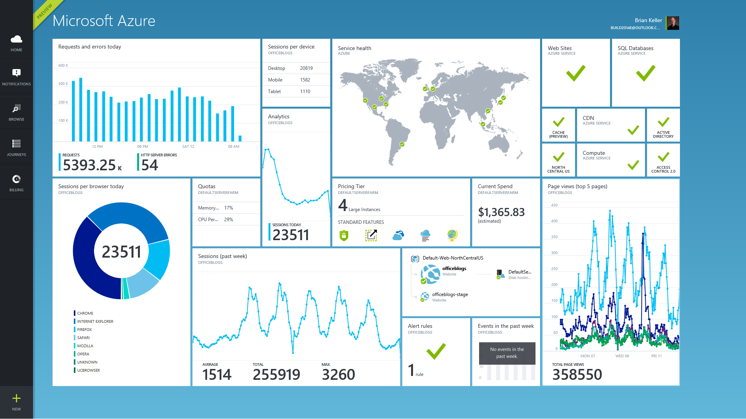
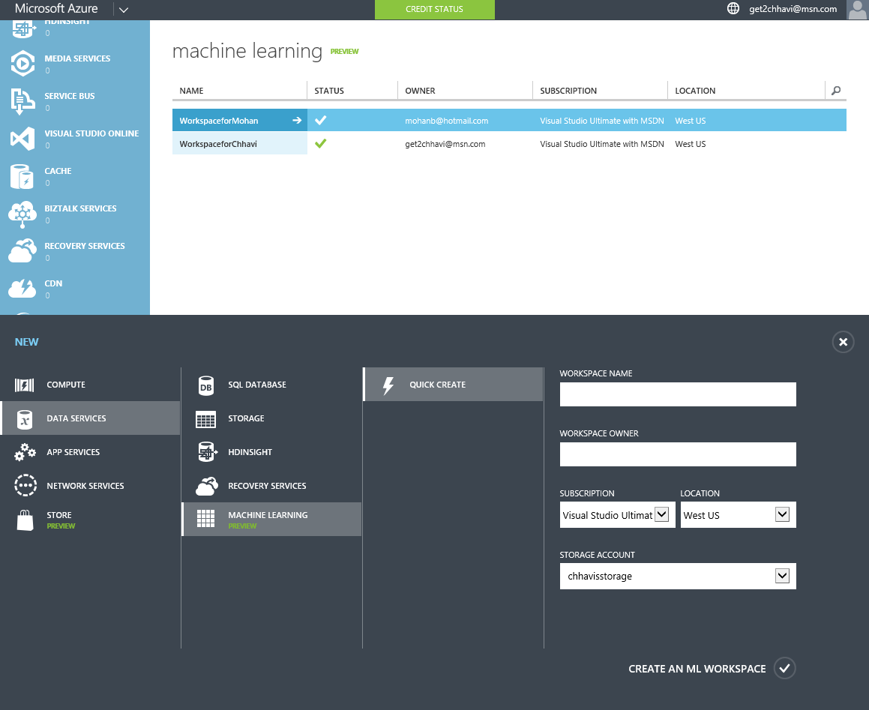
Azure v1 vs. v2
Notes:
Many of the talks here are focussed on AWS, so tonight don’t worry I am not going to convince you to pull up stumps with AWS as it is great platform but want to convey that yes you can do Infra As Code on Azure and if you are a Microsoft centric shop, want to embrace PaaS more than IaaS and have limited Development and DEvOps skill that it may just be the path your looking for.
Just to gauge the audience here tonight
Who here is using the Azure platform
For those who are, who has heard of ARM
Cool
If you are using Microsoft Azure, you may have noticed that up until late last year there was two portals:
Standard Azure Portal: Preview Portal:
The Old Standard Azure Portal is based on the REST API called Service Management while the Preview Portal is based on Azure Resource Manager (ARM). Microsoft introduced ARM to simplify the deployment to Azure via reusable templates. We will see in the next few slides that these templates are declarative and describe the resource and its properties that you want to deploy. So it is easy to deploy throughout your environments spanning from dev and qa through to production all with the same template. In general we all know the benefits of template from preventing human error to snowflaking of your environment. These templates are also reusable in the AzureStack solution . Azure Stack is the on prem reference stacks from HP / Dell to deploy Azure in your in your local DC).

Slide 4
ARM (Azure Resource Manager) Templates
Template-driven
Declarative
Idempotent
Multi-service
Multi region
Extensible
Notes:
On to ARM
In Azure and Azure StackARMi s the management layer or (API) where you connect to for deploying resources. When deploying resources with ARM keep -in mind the following aspects.
Template-driven – Use templates to deploy all resources. IT is API first strategy in Azure v2
Declarative – You declare the resources you want to have instead of imperative where you need to make rules.
Idempotent – You can deploy the template over and over again without affecting the current state of resources.
Multi-service – All services in Azure v2 can be deployed using Azure Resource Manager, IaaS, PaaS, Storage, VMs etc. That today is pretty much everything with just some services that are still on V1. It is an ARM first approach
Multi region- You can choose in which region you would like to deploy the resources.
Extensible – ARM is extensible, it can be linked in to powershell, Chef, Puppet DSC etc.

Slide 5
ARM Templates
Notes:
All this must sound familiar in a nut shell its Microsoft’s equivalent of Cloud Formation

Slide 6
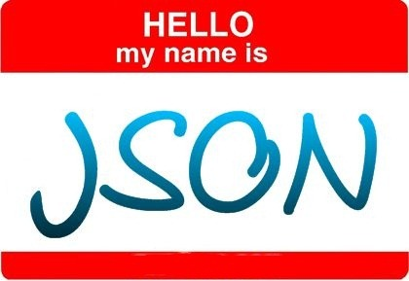
Notes:
As you guessed ARM templates are JSON based and now I am going to explore the structure of these templates and run a quick demo

Slide 7
Core ARM Template Structure
{
"$schema": "https://schema.management.azure.com/schemas/2015-01-01/deploymentTemplate.json#",
"contentVersion": "",
"parameters": {},
"variables": {},
"resources": [],
"outputs": {},
}
Notes:
Switch to VS An ARM Template is a JSON file. I find Visual Studio one of the best tool to author resource templates. Sure there are many tools that understand JSON but not that many that understand Azure. It provides intellisense for authoring templates and also if you use Azure it has native Integration meaning you often never have to login via the web portal. Let’s look closer at the content of this template file. If you take an empty resource template it looks like this:
Some of these fields are required, some are not
$schema – yes : Location of the JSON schema file that describes the version of the template language.
$contentVersion – Yes - Version of the template (such as 1.0.0.0). When deploying resources using the template, this value can be used to make sure that the right template is being used. You might want to patch or relesase code to your infrastructure. All you would need to do is ensure your source code / images etc sre up to to date, incremenent the version and redeploy
$parameters – No - Values that are provided when deployment is executed to customize resource deployment.
Variables – No - Values that are used as JSON fragments in the template to simplify template language expressions. Unless it’s a once off template, use variables
Resources – Yes - Types of services that are deployed or updated in a resource group.
Outputs – No - Values that are returned after deployment.
For the purpose of keeping this high level I am not going to dive any deeper to what I have described

Slide 8
Linked Templates / Parameters
paramters.json
“parameters”: {}
“variables”: {}
resourceStorage.json
“resources”: [
“storage”{},
“vNet”{}
]
resourceVnet.json
azureDeploy.json
URI (GitHub/VSTS/S3/Azure Table Storage)
Notes:
In your ARM templates, you can link to another template which enables you to decompose your deployment into a set of targeted, purpose-specific templates. Just as with decomposing an application into a number of code classes, decomposition provides benefits in terms of testing, re-use, and readability.
You can pass parameters from a main template to a linked template, and those parameters can directly map to parameters or variables exposed by the calling template. The linked template can also pass an output variable back to the source template, enabling a two-way data exchange between templates.
You create a link between two templates by adding a deployment resource within the main template that points to the linked template. You set the templateLink property to the URI of the linked template.

Slide 9
Demo
Notes:
Walk Through ARM Templates in Visual Studio Ensure you open it from explorer and right click VS2015 This template creates 2 Windows VMs in an Availability Set and a Load Balancer with port 80 open. The two VMs can be reached using RDP on port 6001 and 6002 with some port address translatoin. This template also create a SQL Server 2014 VM that can be reached via RDP connection defined in a Network Security Group.All VMs storage can use Premium Storage (SSD) and you can choose to creare VMs with all DS sizes

Slide 10
Deployment – Azure PowerShell
New-AzureRmResourceGroupDeployment `
-Name $DeploymentName `
-ResourceGroupName $AzureResourceGroup.ResourceGroupName `
TemplateFile- azureDeployment.json `
-TemplateParameterFile azureDeployment.parameters.json `
@additionalParameters `
-Verbose -Force
Notes:
Switch to VS Deployment of ARM templates can be performed via the command line or via the Azure portal. I am not going to worry about the GUI tonight and will give you a run down on how you deploy via Azure Powershell and Azure Cross Platform CLI
Installation of Azure Powershell is pretty simple and I have put a link at the end of this deck on how to install the Azure RM module. If you have had Azure Powershell installed in the past you need to be on Version 1 or greater to leverage ARM
The documentation is outdated on the Mircorosft website and doesn’t reflect the latest changed
Login-AzureRmAccount
Get-AzureRmSubscription
Select-AzureRmSubscription -SubscriptionId “insert_your_sub_id“
New-AzureRMResourceGroup –Name “Insert_Name” –Location “Australia SouthEast”
New-AzureRMResourceGroupDeployment -Name DeploymentName -ResourceGroupName Insert_Name -TemplateUri https://raw.githubusercontent.com/azure/azure-quickstart-templates/master/101-vm-simple-windows/azuredeploy.json

Slide 11
Demo
Notes:
Walk Through ARM Templates in Visual Studio

Slide 12
Deployment – Azure xPlat CLI
azure group create "demoRG" "Australia SouthEast"
-f azuredeploy.json
-d "demoDeploy"
-e azuredeploy.parameters.json
Notes:
The Azure Xplatt CLI an as the name implies a Cross platform CLI for Linux, OSX etc. I haven’t tested on anything other than Linux but I have had no issue getting this to run on Ubuntu using NPM.
Once NPM is installed it is as simple as a “npm install azure-cli –g”
For OSX there is a DMG file
It can also run on Widnodws

Slide 13
ARMViz (Azure Resource Visualiser)
Visualise , Edit & Save ARM Templates
Load your own ARM Template or Leverage Gallery
GitHub project
http://armviz.io
Notes:
Open 301-2fe-linux…. ARMViz is a Git Hub project that is a novel way of visualizing your ARM templates. Simple to use and is a way to visualize and even edit your code, particularly useful for those who haven’t made the jump to infra as code but do need to consume or execute these templates as it gives people a way to bring code to life At this stage it does not support exporting of the generated image to a flat file and the existing templates are synced from the Azure Quick Start Template Gallery

Slide 14
Tools of the trade
Microsoft Visual Studio
Visual Studio Code (https://code.visualstudio.com)
Azure Quick Start Templates (https://azure.microsoft.com/en-us/documentation/templates/ )
Atom (https://atom.io)
Notepad++ (with JSONViewer plugin)
Azure Resource Visualizer (http://armviz.io/)
Azure Resource Explorer (https://resources.azure.com)
ARMClient (https://github.com/projectkudu/ARMClient)
Notes:
I have included some links here I find useful and recommend the link on Quick Start Templates as it covers quite a bit of the basics.

Slide 15
Contact Details
@sbaldacchino
shane@baldacchino.net
https://au.linkedin.com/in/shanebaldacchino http://automation.baldacchino.net
Notes:
So that is everything I have for tonight..
I will be posting up the slide deck on my blog, automation.baldacchino.net. I write heavily about building and control systems automation which like most things these days are heavily influenced by code.
If you have any deeper questions not covered in this over view feel free to come and see me tonight , ill be hanging around for a bit or contact me via any of these methods. Once again, thank you. Does anyone have any questions?

